Slide 1
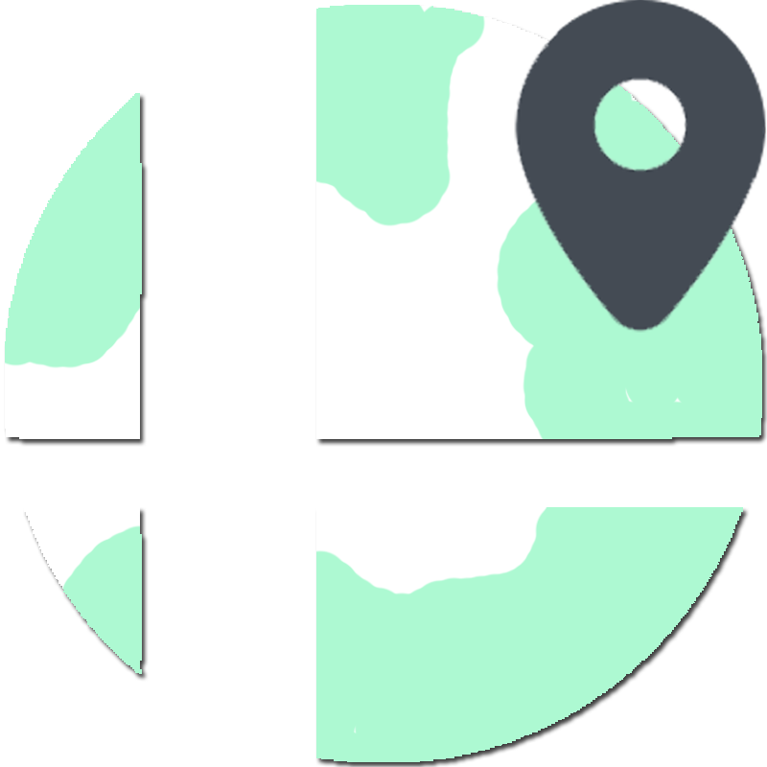
Smash Search
A Super Smash Brothers Tournament Locator
By Tyler P. Berkshire

Slide 2

Fable
F# to JavaScript compiler
Functional programming
Pattern Matching
Immutable Data
Type Safety
Not a full coverage of F#

Slide 3

Elmish
Fable Package
Implements Elm Architecture
Used for interactive program design
“Model view update”
Dispatch loop for promises/async operations

Slide 4
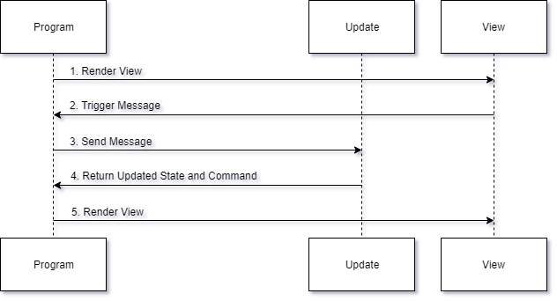
Dispatch Loop

Slide 5

React
Elmish applications can run w/out a UI
React provides components for render
All basic HTML elements
Function components
DOM hooks

Slide 6

Smash.gg API
GraphQL
Clients control data they receive
Multiple data from one request
Tournaments by location
Variables
perPage: maximum items to load
coordinates: Lat/Long of location
maxDistance: distance to search from coordinates
Data
Name, venue address, date, events, entrants...

Slide 7
Code & Demo
https://thumbs.gfycat.com/ImpressionableSereneHoneyeater-size_restricted.gif

